Slide 1
Home Depot Search Relevance
Saad Padela
Umber Singh
Kevin McLanahan

Slide 2

Problem Overview
Home Depot wants an algorithm to predict search relevance
Why: Understand how changes to their search algorithms affect user experience.
Current State: Human raters evaluate a sample of search results on a scale from 1 to 3 (3 = highly relevant)
Future State: Search relevance algorithm will allow dev teams to run through more design iterations

Slide 3
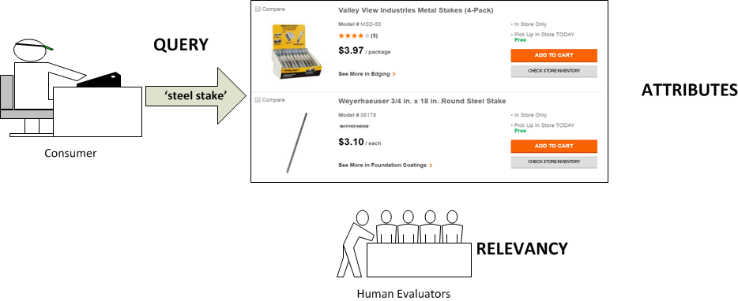
Current Process

Slide 4
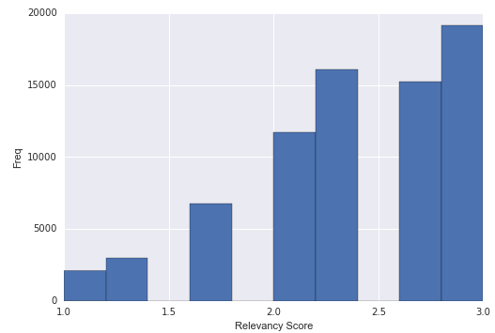
The Data
Relevance Score (label, train only)
Query
Product
Title
Description
Attributes
Hundreds of attributes per product, non-standard classification
For example, a desk lamp would share electrical-attributes with a vacuum cleaner, but the latter would not have any lighting-attributes
Scoring: Based on Root Mean Squared Error (RMSE)
Keyword-Match Benchmark Score: 0.511

Slide 5
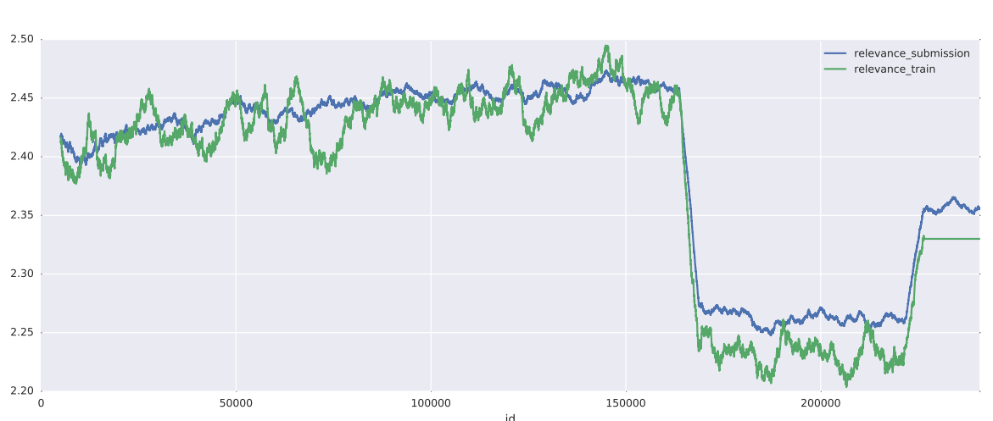
Identified Challenges
After Consolidating Data, we Identified a Few Trends that May Pose Issues:
Importance of Brand
Key part of human relevancy scoring guide
Seen in data, with relevancy score as product ID decreases
Repetitive Query Terms
40% of search-terms appear in both Training and Test datasets
Potential Fix: add unique index value to each query

Slide 6
Feature Engineering
number of words in query
number of query words present in title
sum of the ratio differences of each query word to the title
number of query words present in description
number of query words present in the MFG Brand attribute
sum of the ratio differences of each query word to the MFG Brand attribute
TFIDF word features
* Used a snowball stemmer to try to generalize the word matching
* Used the ratio differences in addition to exact matching to try to account for word misspellings and approximate matches

Slide 7
Top Model Overview
Order | Model | Parameter | Feature Engineering/Selection | What Was Learned/Reference to In-Class Material | Score RMSE
Base |  |  |  |  | 0.63
1.) | Bagging RF Regressor | 20 per Forest 300 per Bagging | Query matching and approximate matches | Bagging helped significantly to reduce the error of this highly muddled data set | 0.48552
2.) | TFIDF + MNB | Alpha = 1.1 | Matched Words | Multinomial Naive Bayes on matched words (w/ tf-idf weighting) helped introduce semantic component to the analysis | 0.71
3.) | Multi-Layer NN | 600 nodes/layer 3 layers | Query matching and approximate matches | Neither rectifier, maxout, nor sigmoid activation was able to achieve good results | 0.5719
4.) | GMM | 4 component, full covariance | Query matching and approximate matches | Tried various methods of clustering inputs and outputs with minimal benefit | 0.5422

Slide 8
First Steps
Model #0 -- Baseline Approach
Baseline approach (via Kaggle/Home Depot) was to submit the mean of the test dataset as the prediction for every observation, irrespective of individual features
Model #1 -- K Nearest Neighbors
Simple model used to generate first submission
Only able to achieve 24% accuracy
Model #2 -- Random Forest Regressor
Regressor generates continuous output (vs. Classifier)
Performed better than KNN, but even after parameter tuning, unable to beat the benchmark approach

Slide 9
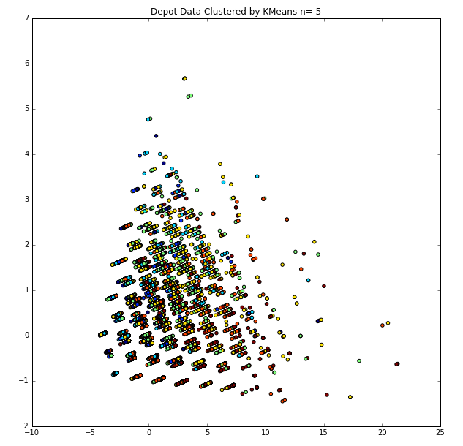
We Tried These Approaches, But...
Model #3 -- Gaussian Mixture Model
2-D projection captured 91% of variance; however, the data did not lend itself to clustering (see right)
Model #4 -- Neural Nets
1,000 Hidden Variables; did not beat RF
Model #5 -- Multinomial Naive Bayes w/ TF-IDF Weighting
Trained on array of matched words between query & title or description, weighted by tf-idf

Slide 10
Our Final Submission
Model #6: Bagging Regressor with Random Forest
Needed a model that incorporated errors into the predictions
A bagging regressor with random forest regressors as the base estimator proved to be the top performer
Achieved a R^2 score of 0.082, the only model to beat guessing the mean for every data point regardless of features.

Slide 11
Next Steps
Feature Engineering
Most of the techniques we implemented were based on counting the number of matching words between the query and either the product title, description, or a subset of its attributes.
The key to improved performance is adding new features...perhaps do more with attributes (e.g., infer category given presence of category-specific attributes, or size-based comparison with height/length/weight)
Without prior experience in search, we found it difficult to ideate on new features
Re-visit TFIDF/MNB; focus on identifying crucial match words
Create ensemble models by polling the results of multiple techniques

